Slide 1
Learning Objective
CFU
What will we learn today?
I will be able to determine Midpoint, Distance and Gradient of two coordinates
CFU
How will you know that you are successful?
Success Criteria
At the end of the lesson, I will be able to:
Determine the midpoint of two coordinates
Determine a set of coordinate given the midpoint and one other coordinate
Determine the distance of two coordinates
Determine the gradient of two coordinates

Slide 2
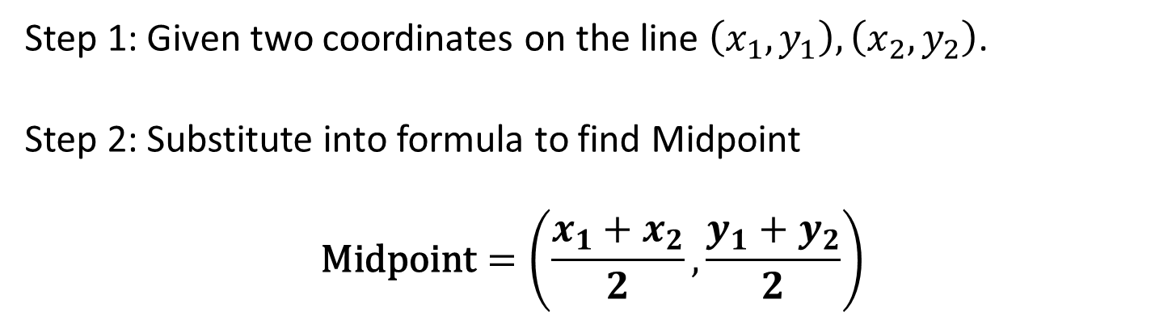
Activating Prior Knowledge
y
Finding midpoint
Step 1: Given two coordinates on the line $\left(x_{1},y_{1}\right), \left(x_{2},y_{2}\right)$.
Step 2: Substitute into formula to find Midpoint
$$\text{Midpoint}=\left(\frac{x_{1}+x_{2}}{2},\frac{y_{1}+y_{2}}{2}\right)$$
(x₂, y₂)
(x_{m}, y_{m})
x
(x₁, y₁)

Slide 3
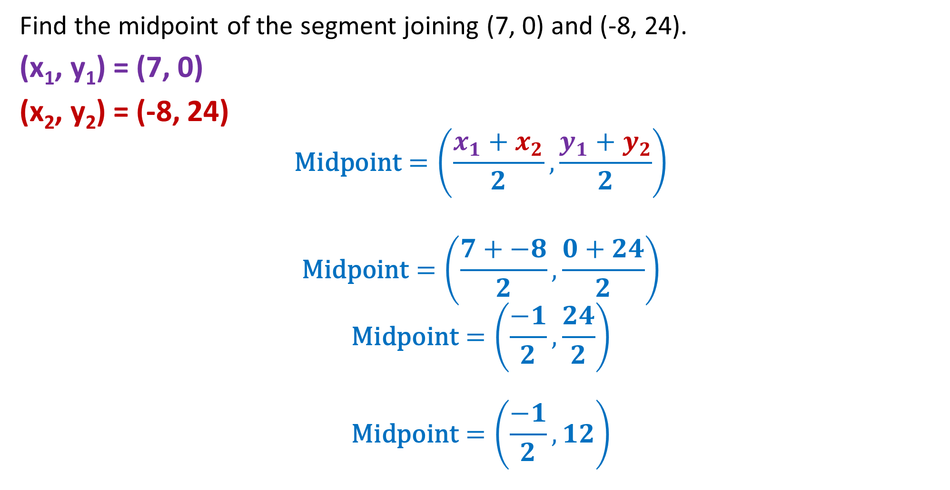
Finding the Midpoint of a segment
Find the midpoint of the segment joining (7, 0) and (-8, 24).
(x₁, y₁) = (7, 0)
(x₂, y₂) = (-8, 24)
$$\text{Midpoint}=\left(\frac{x_{1}+x_{2}}{2},\frac{y_{1}+y_{2}}{2}\right)$$
$$\text{Midpoint}=\left(\frac{7+−8}{2},\frac{0+24}{2}\right)$$
$$\text{Midpoint}=\left(\frac{−1}{2},\frac{24}{2}\right)$$
$$\text{Midpoint}=\left(\frac{−1}{2},12\right)$$

Slide 4
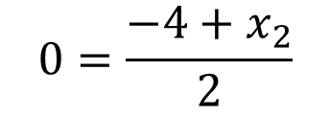
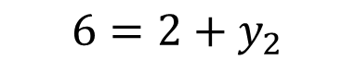
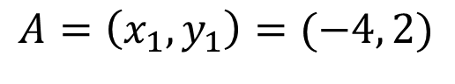



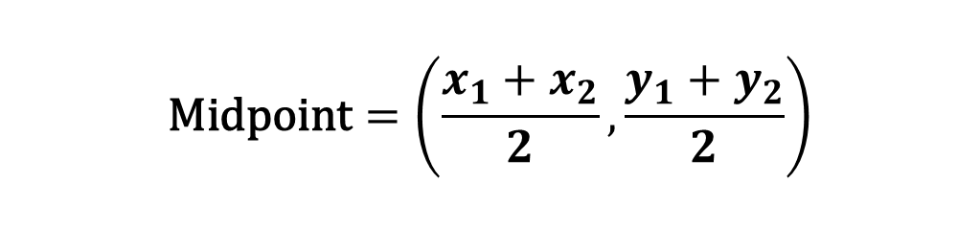
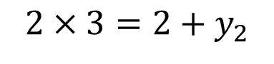
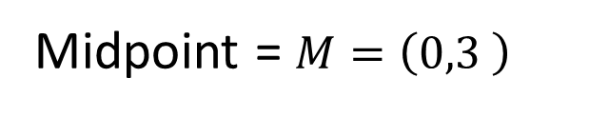

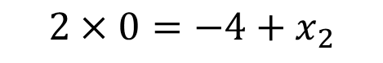
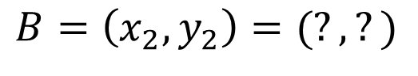
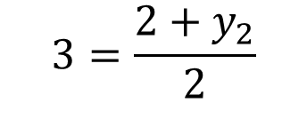

Finding the Midpoint of a segment
If the midpoint of AB is $(0,3)$ and coordinates of A is $\left(−4,2\right).$ Find B.
$$\text{Midpoint}=\left(\frac{x_{1}+x_{2}}{2},\frac{y_{1}+y_{2}}{2}\right)$$
$$A=\left(x_{1},y_{1}\right)=(−4, 2)$$
$$B=\left(x_{2},y_{2}\right)=(?, ?)$$
Midpoint = $M=\left(0,3 \right)$
$$\text{(0,}3)=\left(\frac{−4+x_{2}}{2},\frac{2+y_{2}}{2}\right)$$
$$0=\frac{−4+x_{2}}{2}$$
$$3=\frac{2+y_{2}}{2}$$
$$2×0=−4+x_{2}$$
$$2×3=2+y_{2}$$
$$0=−4+x_{2}$$
$$6=2+y_{2}$$
$$4=x_{2}$$
$$4=y_{2}$$
$$B=\left(4, 4\right)$$

Slide 5
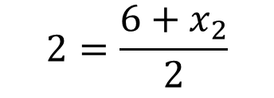
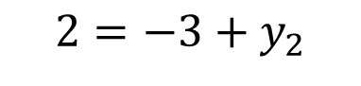
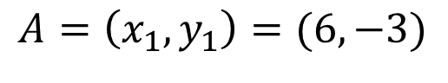
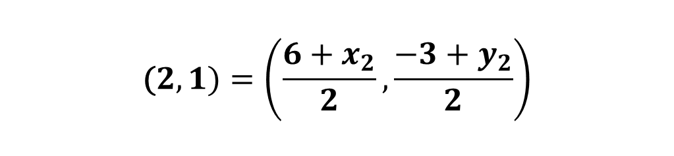


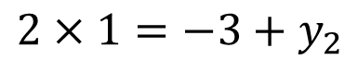
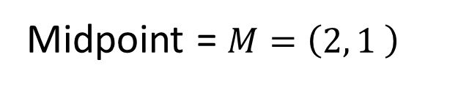


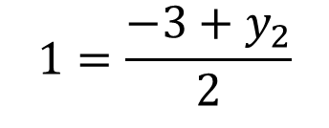

Finding the Midpoint of a segment
If the midpoint of AB is $(2, 1)$ and coordinates of A is $\left(6,−3\right).$ Find B.
$$\text{Midpoint}=\left(\frac{x_{1}+x_{2}}{2},\frac{y_{1}+y_{2}}{2}\right)$$
$$A=\left(x_{1},y_{1}\right)=(6,−3)$$
$$B=\left(x_{2},y_{2}\right)=(?, ?)$$
Midpoint = $M=\left(2, 1 \right)$
$$\text{(}2,1)=\left(\frac{6+x_{2}}{2},\frac{−3+y_{2}}{2}\right)$$
$$2=\frac{6+x_{2}}{2}$$
$$1=\frac{−3+y_{2}}{2}$$
$$2×2=6+x_{2}$$
$$2×1=−3+y_{2}$$
$$4=6+x_{2}$$
$$2=−3+y_{2}$$
$$−2=x_{2}$$
$$5=y_{2}$$
$$B=\left(−2,5\right)$$

Slide 6
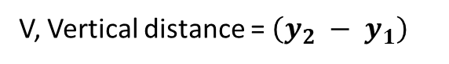
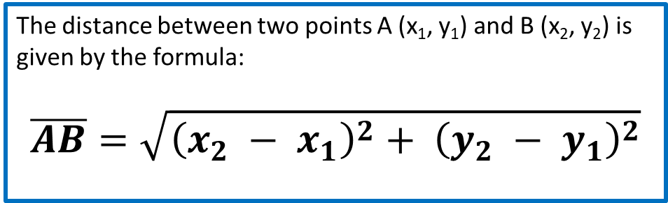
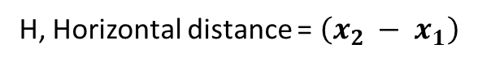
y
Calculating Distance
Distance between two points
A (x₁, y₁)
V, Vertical distance = $\left(y_{2} − y_{1}\right)$
x
B (x₂, y₂)
H, Horizontal distance = $\left(x_{2} − x_{1}\right)$
The distance between two points A (x₁, y₁) and B (x₂, y₂) is given by the formula:
$$\overline{AB}=\sqrt{{\left(x_{2} − x_{1}\right)}^{2}+ {\left(y_{2} − y_{1}\right)}^{2}}$$

Slide 7
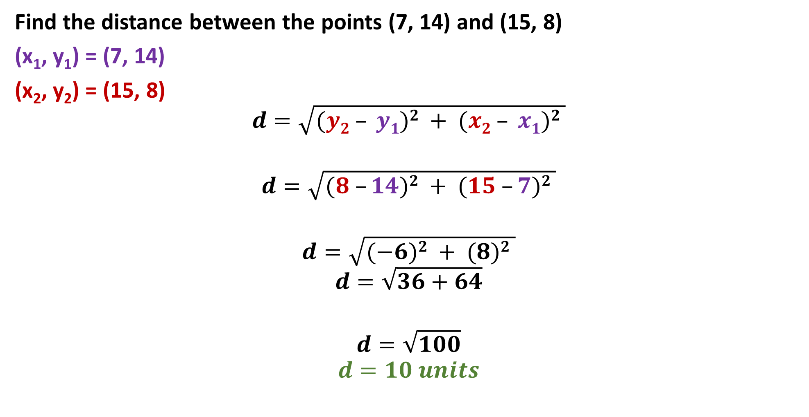
Guided Practice
Find the distance between the points (7, 14) and (15, 8)
(x₁, y₁) = (7, 14)
(x₂, y₂) = (15, 8)
$$d=\sqrt{(y2 – y1)2 + (x2 – x1)2 }$$
$$d=\sqrt{(8 –14)2 + (15 –7)2 }$$
$$d=\sqrt{(−6)2 + (8)2 }$$
$$d=\sqrt{36+64}$$
$$d=\sqrt{100}$$
$$d=10 units$$

Slide 8
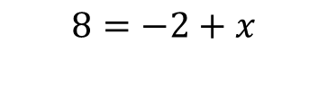
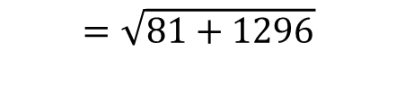
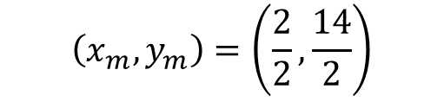
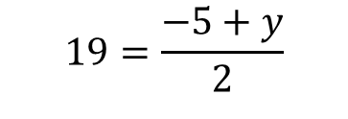
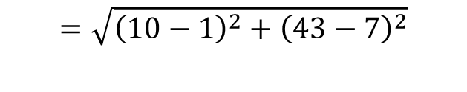
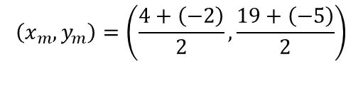
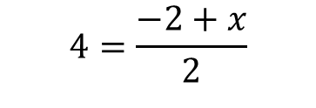
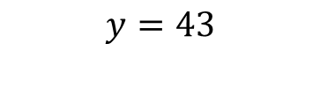
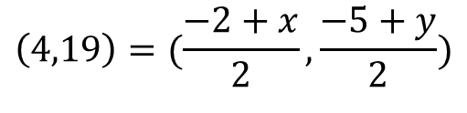


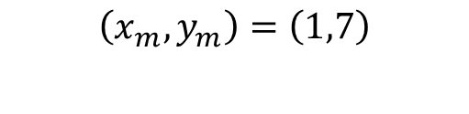
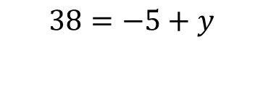

Guided Practice
Points A, B, C and D lie on a straight line. The co-ordinate of points A and C are (-2, -5) and (4, 19). Determine
The co-ordinate of B given that point B is the midpoint of A and C;
The co-ordinate of point D given that point C is the midpoint of A and D;
The distance between point B and D.
Distance of points BD
$$\left(x_{m},y_{m}\right)=\left(\frac{4+\left(−2\right)}{2},\frac{19+\left(−5\right)}{2}\right)$$
$$\left(4,19\right)=(\frac{−2+x}{2},\frac{−5+y}{2})$$
$$=\sqrt{{\left(10−1\right)}^{2}+{\left(43−7\right)}^{2}}$$
$$\left(x_{m},y_{m}\right)=\left(\frac{2}{2},\frac{14}{2}\right)$$
$$4=\frac{−2+x}{2}$$
$$19=\frac{−5+y}{2}$$
$$=\sqrt{81+1296}$$
$$=\sqrt{1377}$$
$$\left(x_{m},y_{m}\right)=\left(1,7\right)$$
$$8=−2+x$$
$$38=−5+y$$
$$=37.11$$
$$x=10$$
$$y=43$$

Slide 9

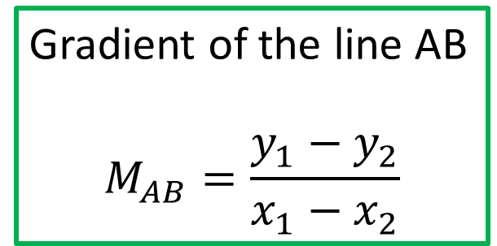

Calculating Gradient
y
Gradient of the line AB
$$M_{AB}=\frac{y_{1}−y_{2}}{x_{1}−x_{2}}$$
A (x₁, y₁)
$$θ$$
x
$$θ$$
B (x₂, y₂)

Slide 10
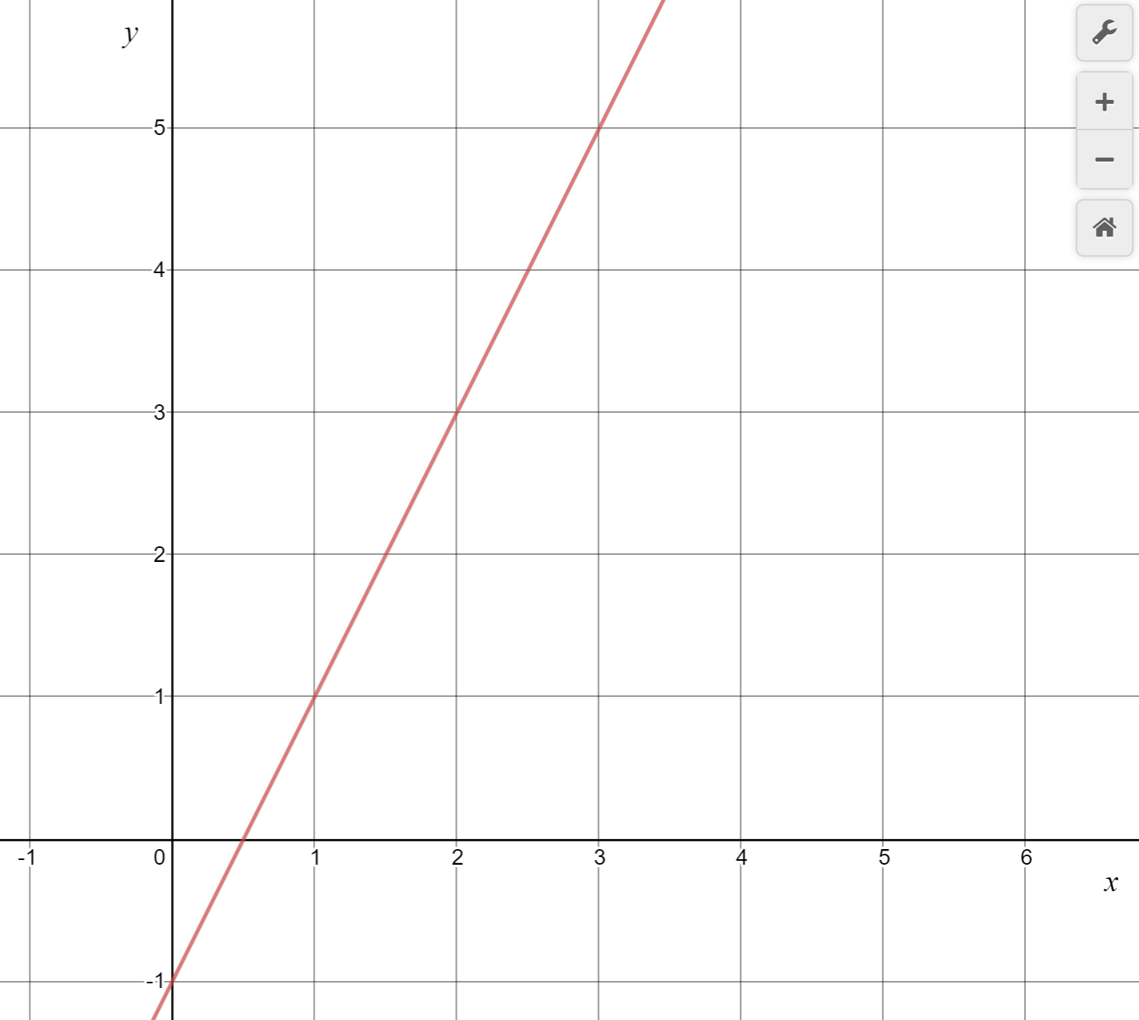
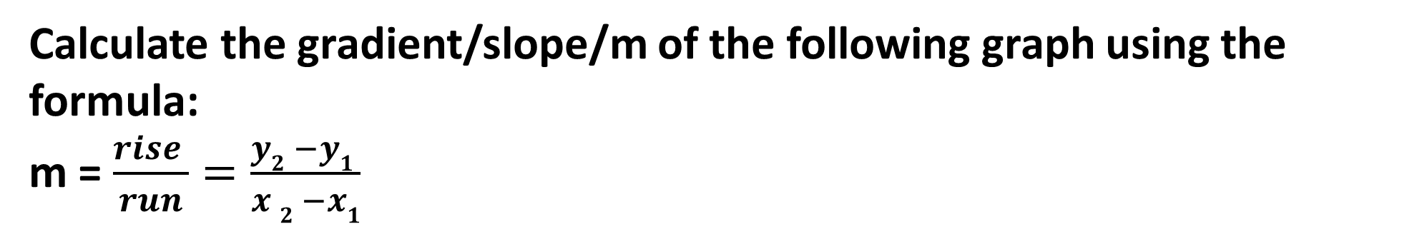
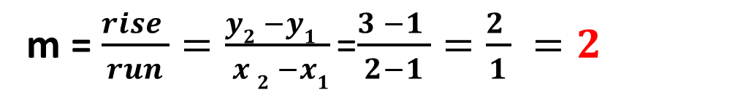
Calculating Gradient
Calculate the gradient/slope/m of the following graph using the formula:
m = $\frac{rise }{run}=\frac{y2 −y1 }{x 2 −x1}$
1. Identify two easy points
2. Label them as (x₁,y₁) and (x₂,y₂)
Run = 1
(x₁,y₁) = (2,3)
3. Substitute them into the formula
Rise = 2
(x₂,y₂)= (1,1)
m = $\frac{rise }{run}=\frac{y2 −y1 }{ x 2 −x1}$=$\frac{3 −1 }{2−1}=\frac{2 }{1} =2$

Slide 11
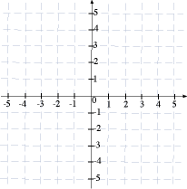
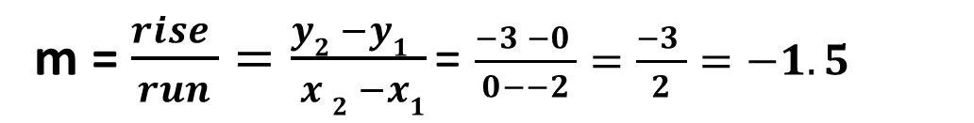
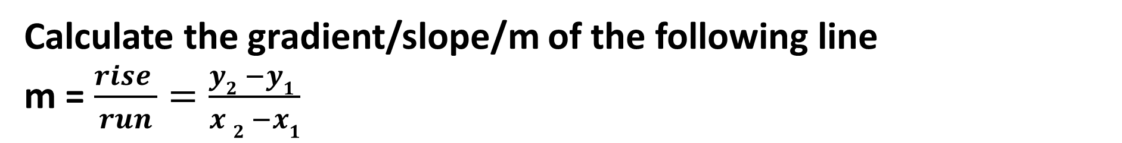
Gradient
Calculate the gradient/slope/m of the following line
m = $\frac{rise }{run}=\frac{y2 −y1 }{x 2 −x1}$
1. Identify two easy points
2. Label them as (x₁,y₁) and (x₂,y₂)
3. Substitute them into the formula
(x₁,y₁) = (-2,0)
Rise = -3
(x₂,y₂)= (0,-3)
m = $\frac{rise }{run}=\frac{y2 −y1 }{ x 2 −x1}$= $\frac{−3 −0 }{0−−2}=\frac{−3 }{2}=−1.5$
Run = 2

Slide 12
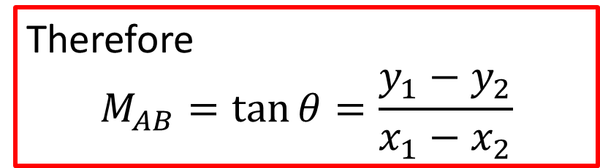
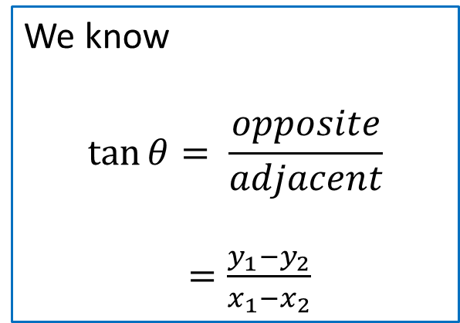
Calculating Gradient
y
Gradient of the line AB
$$M_{AB}=\frac{y_{1}−y_{2}}{x_{1}−x_{2}}$$
A (x₁, y₁)
We know
$$\tan{θ}= \frac{opposite}{adjacent}$$
$=\frac{y_{1}−y_{2}}{x_{1}−x_{2}}$
$$θ$$
x
$$θ$$
B (x₂, y₂)
Therefore
$$M_{AB}=\tan{θ}=\frac{y_{1}−y_{2}}{x_{1}−x_{2}}$$

Slide 13
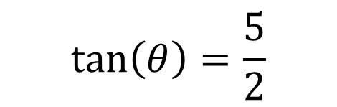
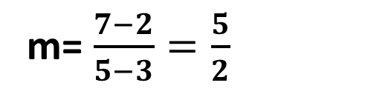

Gradient
Calculate the gradient of the line passing through the points (3, 2) and (5,7) and the angle of inclination
Find the gradient:
m= $\frac{7−2}{5−3}=\frac{5}{2}$
Gradient is positive so the angle is acute
$$\tan\left(θ\right)=\frac{5}{2}$$
$$θ=68.20°$$

Slide 14
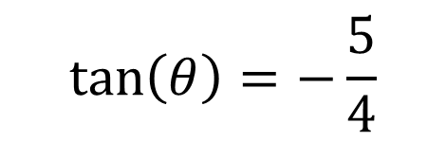
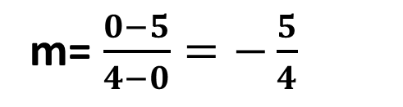
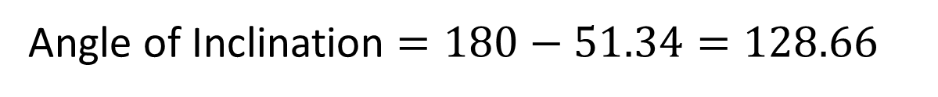

Gradient
Calculate the gradient of the line passing through the points (0,5) and (4,0) and the angle of inclination.
Find the gradient:
m= $\frac{0−5}{4−0}=−\frac{5}{4}$
Gradient is negative so the angle is obtuse
$$\tan\left(θ\right)=−\frac{5}{4}$$
$$θ=−51.34$$
Angle of Inclination $=180−51.34=128.66$

Slide 15
Gradient
CFU 1
What do you notice about the slope of the line?
CFU 1
What do you notice about the slope of the line?
Consider the following special graphs
Calculate the gradient/slope/m of the following graph:
CFU 2
What is the gradient of this line?
CFU 2
What is the gradient of this line?
This graph has no slope
Therefore, m = 0

Slide 16

Gradient
CFU 1
What do you notice about the slope of the line?
Consider the following special graphs
Calculate the gradient/slope/m of the following graph:
CFU 2
What is the gradient of this line?
This graph has the steepest slope!
Therefore, m = $undefined$

Slide 17
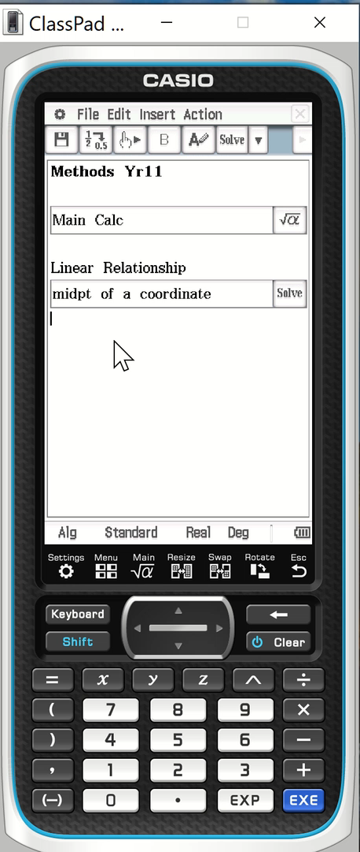
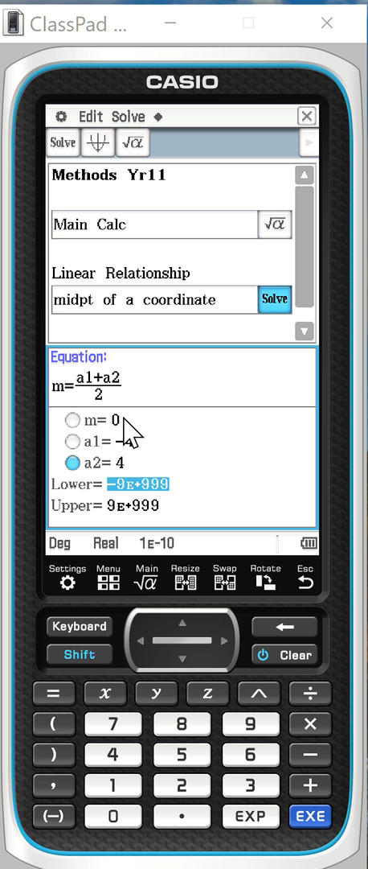
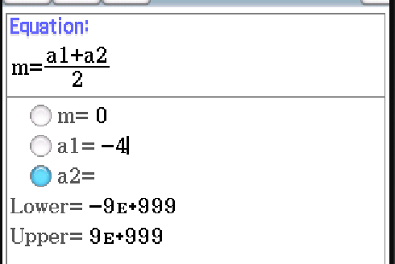




Using ClassPad
If the midpoint of AB is $(0,3)$ and coordinates of A is $\left(−4,2\right).$ Find B.
$$A=\left(x_{1},y_{1}\right)=(−4, 2)$$
To find x: Enter m = 0, a1 = -4, select a2 > solve
To find y: Enter m = 3, a1 = 2 > select a2 > solve
$$B=\left(x_{2},y_{2}\right)=(?, ?)$$
Midpoint = $M=\left(0,3 \right)$
$$\text{Midpoint}=\left(\frac{x_{1}+x_{2}}{2},\frac{y_{1}+y_{2}}{2}\right)$$
$$\text{(0,}3)=\left(\frac{−4+x_{2}}{2},\frac{2+y_{2}}{2}\right)$$
$$B=\left(4, 4\right)$$

Slide 18
Independent Practice
Complete Cambridge Ex 2A and 2B

